Slide 1
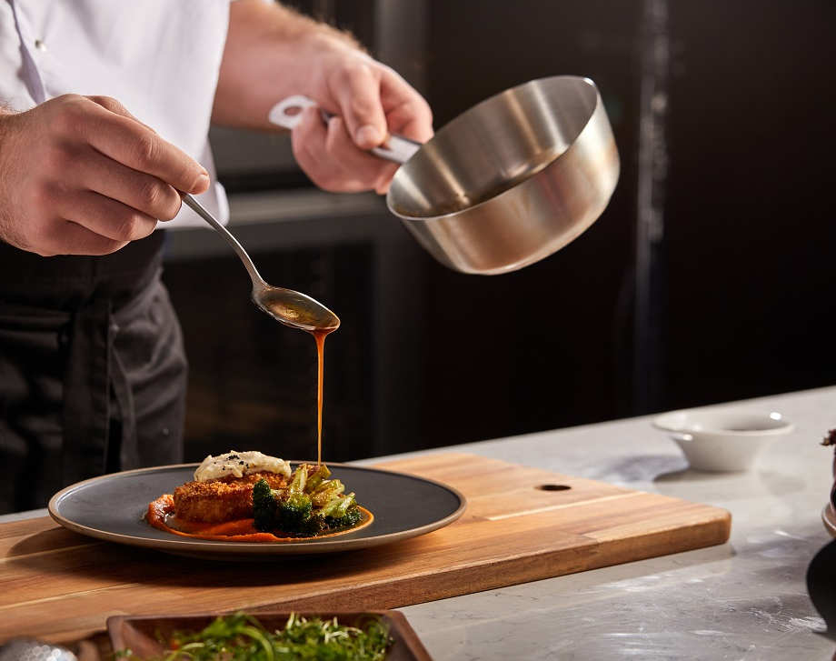
Kitchen Chronicle
By:
Uday Suhas Nakkapalli
Greeshma Pothineni
Project Guide
Shruthi Varma

Slide 2
Overview:
1. Introduction
2. Dataset
3. Entities and Attributes
4. Conceptual Model
5. Logical Model
6. Demo of Application
7. Areas of Improvement
8.Challenges

Slide 3
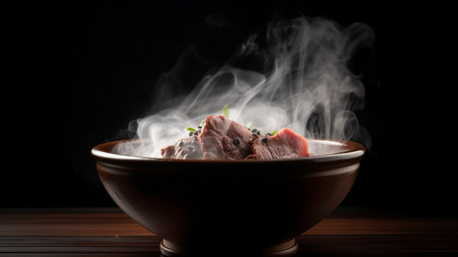
Introduction
Is there anyone here who doesn’t like food?
The significance of food extends beyond its flavors and nutritional value; it encapsulates stories of resilience, adaptation, and creativity.
It's a digital passport to a world of flavors, transforming the kitchen into a gateway where the richness of global gastronomy is accessible to all.
This presentation is a celebration of the diverse and vibrant world of food—a journey through flavors, techniques, and the cultural significance of cuisines across the globe.

Slide 4
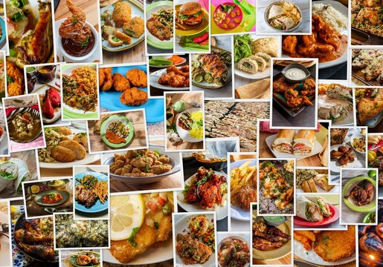
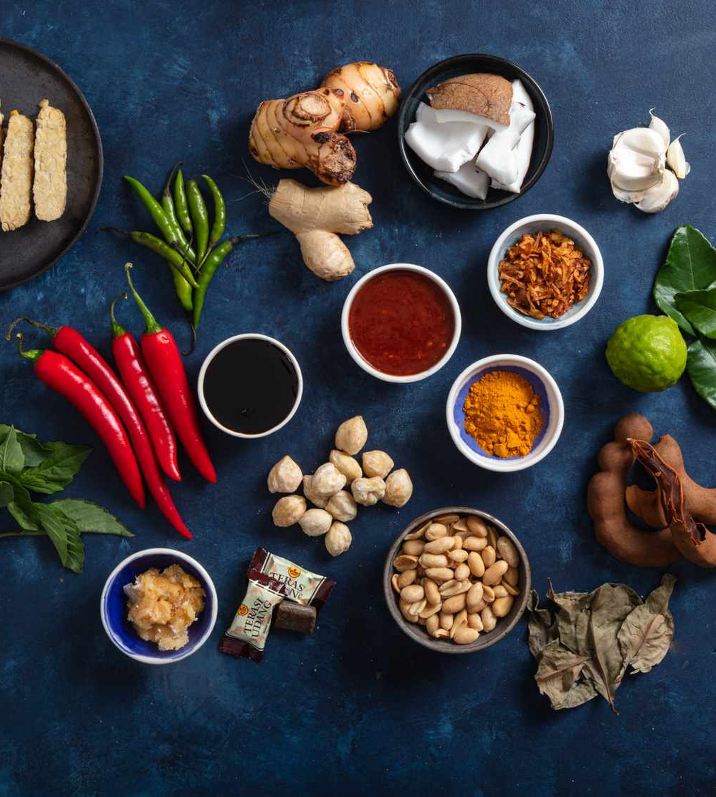




Data Sets:
Cusines
Ingredient
Recipes
Cooking Steps
Review
Users

Slide 5
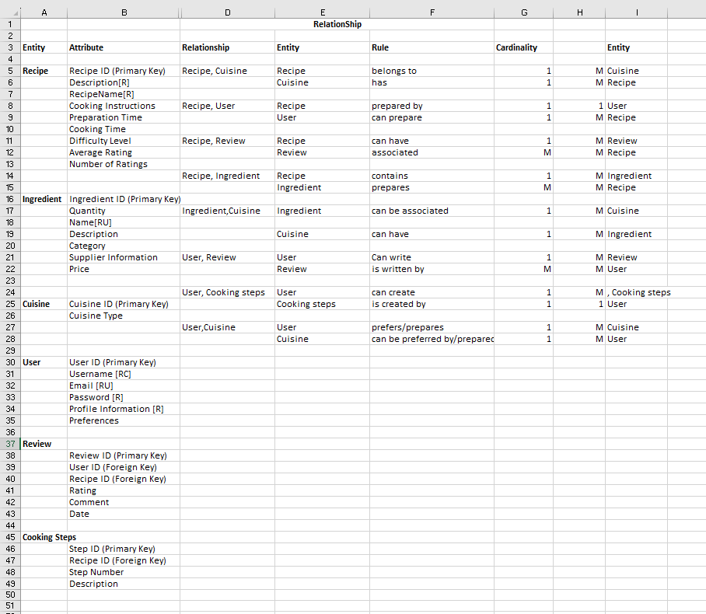
Entities and attributes:

Slide 6
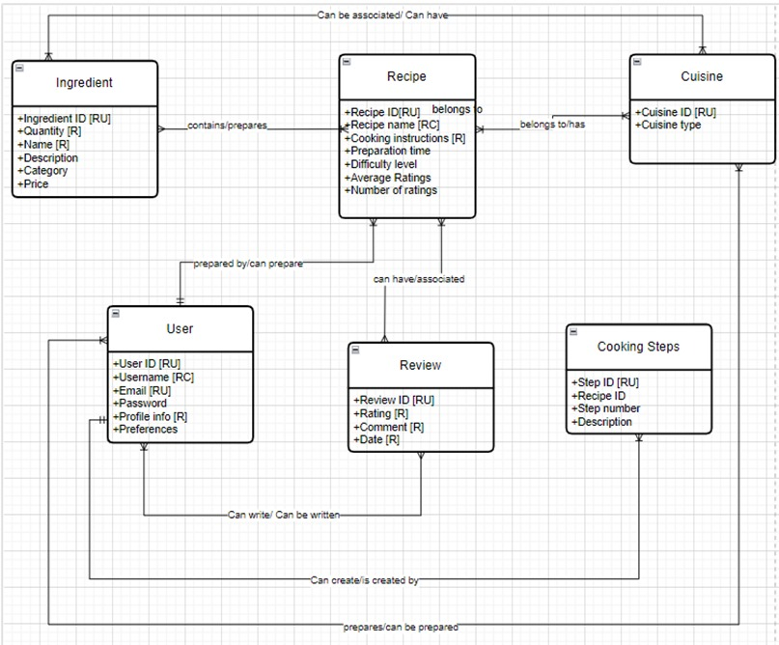
Conceptual Diagram:

Slide 7
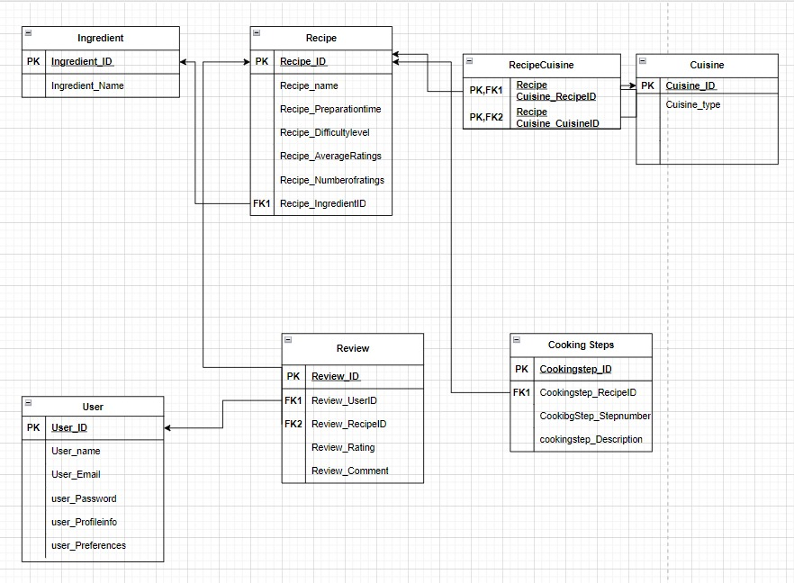
Logical Diagram:

Slide 8

Project demo

Slide 9
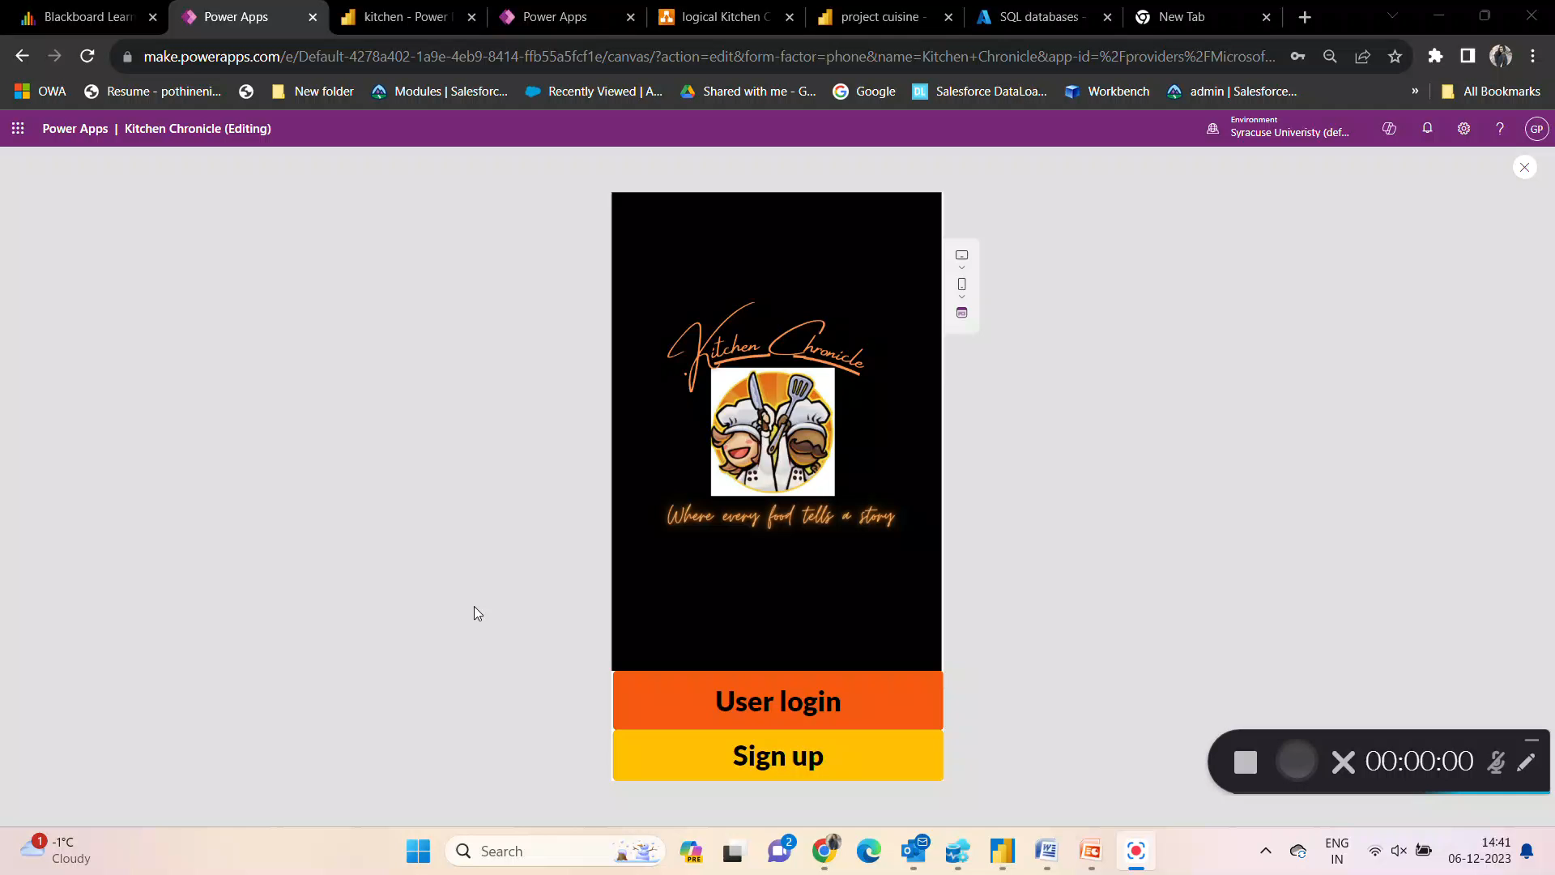

Slide 10
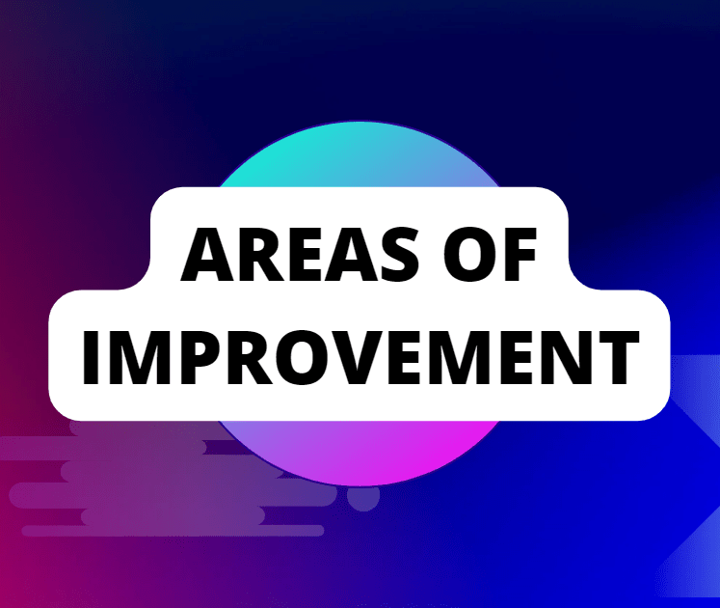

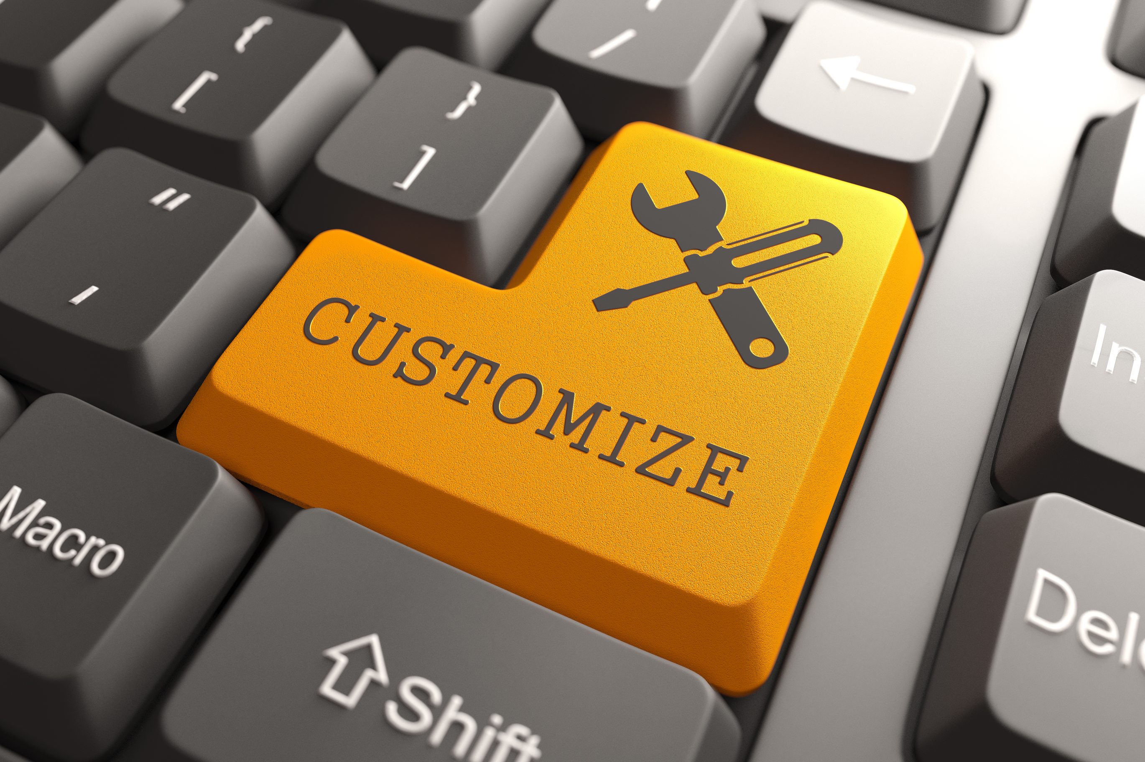
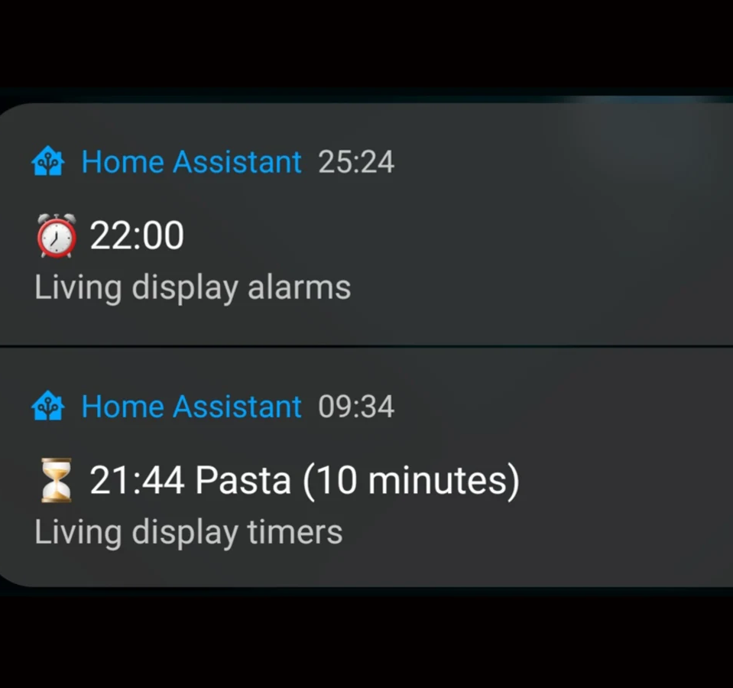
Enhanced Search and Filtering:
Implement advanced search and filtering options, allowing users to quickly find recipes.
Recipe Customization:
Allow users to customize recipes based on dietary restrictions, personal preferences.
Cooking Timers and Notifications:
Integrate cooking timers within the app to help users to manage multiple recipes simultaneously with the notifications

Slide 11



Redirecting to error screen for invalid credentials
Designing visualizations and using BI tools
Redirecting to error screen for invalid credentials
Designing visualizations and using BI tools

Slide 12


